Slide 1
The Scrum Framework
COMP 2151 Agile Software Development
Lecture 2
Scrum Principles
Scrum Aspects
Scrum Processes

Slide 2
Scrum Principles
1.1 Empirical Process Control
1.2 Self-organization
1.3 Collaboration
1.4 Value-based Prioritization
1.5 Time-boxing
1.6 Iterative Development

Slide 3
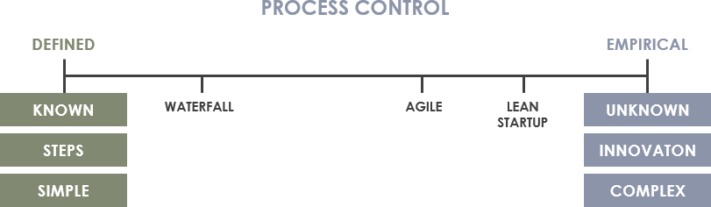
1.1 Empirical Process Control
“Empirical process control expects the unexpected, while defined process control expect every piece of work to be completely understood in upfront.”
progress is based on observation and experimentation instead of detailed, upfront planning and defined processes.
https://www.visual-paradigm.com/scrum/empirical-vs-defined-process-control/

Slide 4
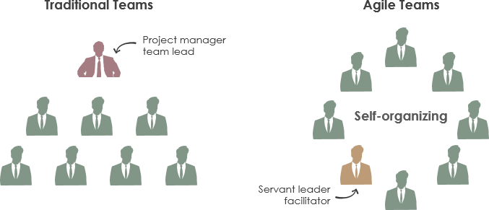
1.2 Self-Organization
Scrum teams are self-organizing and the team chooses how best to accomplish its work instead of being directed/controlled by any one not even the Scrum Master.
team members participating actively & collectively in all the Scrum practices and events.
https://www.visual-paradigm.com/scrum/empirical-vs-defined-process-control/

Slide 5
1.3 Collaboration
The Agile Manifesto proposes to prefer “customer collaboration over contract negotiation.” and “individual and interactions over processes and control”.
The scrum team consisting of the scrum master, product owner, development team collaborate with each other and the client.
Co-location of the team has also facilitates collaboration.

Slide 6
1.4 Value-based Prioritization
Product Backlog items (or software features) are prioritized based on their business value addition.
The “business value” could be derived by getting customer input based on interviews, surveys and then analysed using financial analytical tools.
Feature dependencies and associated risks are also taken into account.

Slide 7
1.5 Time-boxing
A time management method used in scrum. Time is considered an important constraint in Scrum.
Activities are assigned fixed time durations called “time boxes”.
The basic time box is a sprint that may last from one to six weeks. A one week sprint would typically consists of the following :
Sprint Planning: 2 hrs
Daily Scrum: 15 mins
Sprint Review: 1 hr
Sprint Retrospective: 1hr

Slide 8
1.6 Iterative Development
User stories are implemented as features gradually in multiple iterations (sprints) instead of one go.
Sprint team better understands the story after each iteration.
Change requests from the client can be implemented in next iterations.
“Scrum and agile are both incremental and iterative. They are iterative in that they plan for the work of one iteration to be improved upon in subsequent iterations. They are incremental because completed work is delivered throughout the project.” Mike Cohn [Essential Scrum]

Slide 9
2 Scrum Aspects
2.1 Organization
2.2 Business Justification
2.3 Quality
2.4 Change
2.5 Risk

Slide 10
2.1 Organization
The scrum team is organized into core and non core roles
Core Roles
Scrum Master
Product Owner
Development Team
Non Core Roles
Stakeholders: customers, end users, sponsors
Vendors
Scrum Guidance body ( an organization specific team of experts and documents to guide scrum projects)

Slide 11
2.2 Business Justification
To make sure that the development and implementation of the project would add value to the organization (tangible or intangible)
Tangible value could be assessed using financial tools such as ROI (Return on Investment), NPV (Net Present value) or IRR (Internal Rate of Return)
Intangible value is hard to quantify; customer satisfaction, public service etc.

Slide 12
2.3 Quality
“The ability of the completed product or deliverables to meet the acceptance criteria and achieve the business value expected by the customer.” [SBOK]
Quality Management: Quality Planning, Control and Assurance
Continuous improvement of the Product Backlog Items.
Acceptance Criteria: Each user story has an ‘acceptance criteria” to ensure quality.
Done Criteria: Acceptance criteria for the entire product (instead od each user story)

Slide 13
2.4 Change
Traditionally change was viewed as a threat but in modern management style it is viewed as “good” and an “opportunity” for improvement.
Change Management: The process for change implementation should be formalized; Change Requests . [The Scrum Guidance Body usually defines a process for approving and managing changes throughout the organization]
Changes in user stories will trigger change in the Prioritized Product Backlog and the process of updating both items is called “Grooming” the Product Backlog.

Slide 14
2.5 Risk
Risk is defined as “an uncertain event that can affect the objectives of a project and may contribute to its success or failure.”
Risk Management
Risk identification: various techniques
Risk assessment: potential impact on the project
Risk prioritization:
Risk mitigation: develop a strategy
Risk communication: Communicating to all stakeholders (transparency)
Reference: SBOK

Slide 15
3. Scrum Processes
1.Create Project Vision
2. Identify Scrum Master and Stakeholder(s)
3. Form Scrum Team
4. Develop Epic(s)
5. Create Prioritized Product Backlog
6. Conduct Release Planning
7. Create User Stories
8. Estimate User Stories
9. Commit User Stories
10. Identify Tasks
11. Estimate Tasks
12. Create Sprint Backlog
13. Create Deliverables
14. Conduct Daily Standup
15. Groom Prioritized Product Backlog
16. Demonstrate and Validate Sprint
17. Retrospect Sprint Release
18. Ship Deliverables
19. Retrospect Project

Slide 16
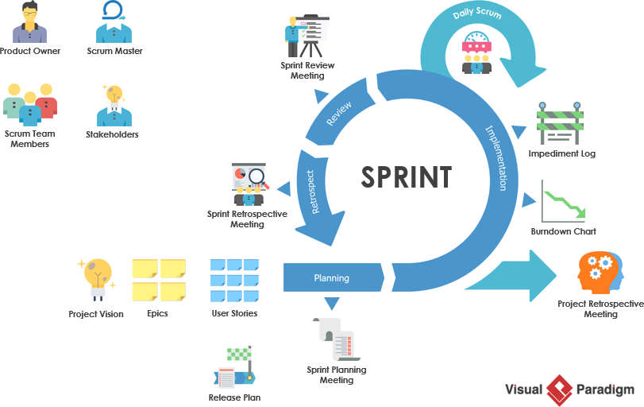
Scrum Canvas (Visual Paradigm)
https://www.visual-paradigm.com/scrum

Slide 17
Scrum Key Roles
The Product Owner: represents the client
The Scrum Master: servant leader/ team facilitator
The Development Team: who develop the technical features
Stakeholders: Client, Project Sponsor, Vendors etc..

Slide 18
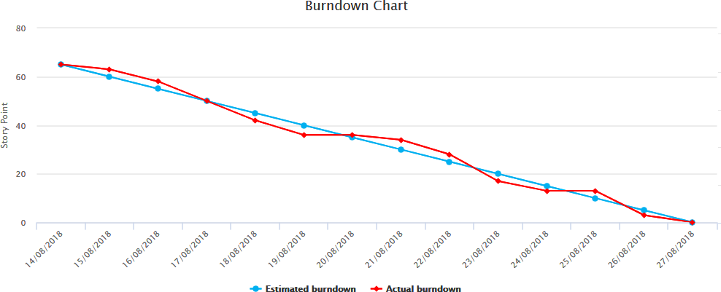
Scrum artifacts
Product backlog: Comprehensive list of the user stories that determine the functionality of the system.
Sprint backlog: stories included in the current sprint.
Burn-down chart: a timeline representation of work to be done.
https://www.visual-paradigm.com/scrum

Slide 19
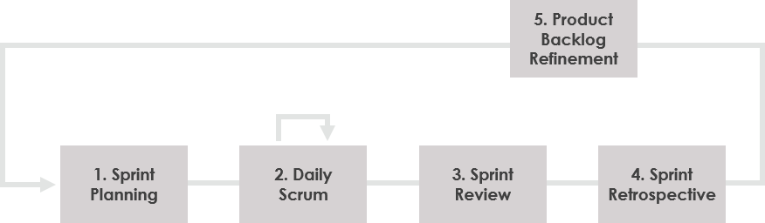
Scrum Events
https://www.visual-paradigm.com/scrum

Slide 20
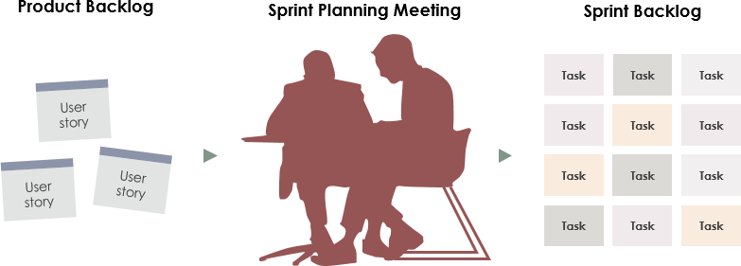
Product vs Sprint Backlog
https://www.visual-paradigm.com/scrum

Slide 21
Personas
A user persona is an archetype or character that represents a potential user of your website or app.
In user centered-design, personas help the design team to target their designs around users.
There is usually more than one type of user who will interact with your website or app, and creating personas helps to scope out the range of users.

Slide 22
Benefits of using personas
For UX(User Interface) teams, introducing persona development into the design process helps them learn about the spectrum of goals and needs of their users.
It is a designer’s checklist if you like.

Slide 23
How to create a persona?
Creating a user persona starts with user research. By observing users, UXers can understand their behavior and motivations, and then design accordingly.
Upon observing users, UXers split up the test data into possible user archetypes, or user personas. Then all this information is put into context in a user persona template

Slide 24
Capturing info about users
There are plenty of user research techniques that help to capture information about user, such as:
task analysis (card sorting, first click testing etc.)
feedback (contextual interviews and focus groups)
prototyping (experimenting with ideas prior to developing them)

Slide 25










PERSONALITY
BIO
“
“I’m looking for a fast way to request a company loan on the go.”
Determined
Organized
Practical
Resourceful
Compassionate
“
Charlotte is founder of a small consulting firm, which she set up 5 years ago. The company is growing and she wants to reward the hard work of her team with bonuses. She also wants to hire a new employee to take some of the heat off her current team. She would like to ask the bank for a loan to go ahead with her plans.
She is married with two kids and a dog. She loves to run and after a long day at the office, she is usually at the gym, if she isn’t travelling for a client meeting. Her work requires her to be tech-inclined and she spends a substantial amount of time on her smartphone because of this.
Behavior
Online banking (desktop)
Text banking (SMS)
Mobile banking (apps)
Motivations
In-person banking
INCENTIVE
GROWTH
Telephone banking
NOTE: One person may have multiple roles in the system. In our personas and stories we stick to a single role of a single persona!
ACHIEVEMENT
POWER
Influences
Goals
Frustrations
· CREDIBILITY
· CLIENTS
· TECHNOLOGY
· BLOGS/ FORUMS
· FAMILY
· SPORTS
To be able to request a loan quickly and easily
Hire a new employee rather than outsourcing
Grow her startup 5% in the next 3 years
Spend more time with her family
Overworking current team, wants
to expand but doesn’t have funds
Has no time for paperwork or long turnaround time outside of the office
Works long hours, travels a lot and banks are often closed or have long queues when she has time to go
CHARLOTTE WALKER
43, Los Angeles
Frequently used apps
FOUNDER
^{· STATUS}
^{MARRIED}
^{· TIER}
^{SENIOR MAN.}
^{· SALARY}
^{$50K}
^{· ARCHETYPE}
^{THE BOSS}
Bank of America
Google Calendar
PocketGuard

Slide 26
User Stories

Slide 27
User stories
A user story is a short statement or abstract that identifies the user and their need/goal. It determines who the user is, what they need and why they need it.
As we touched on above, there are often multiple user personas – it’s a good thing that user stories are brief!
They put things in context and focus on the ‘holistic’ rather than the ‘artifact’.

Slide 28
Benefits of stories
User stories help to document practical information about users, such as the different needs and motivations for accessing a website or app.
They also help the development team estimate a roadmap needed to deliver the end product.

Slide 29
How to write
It’s super simple to write a user story. Just follow the pattern:
“As a [role], I want [feature] because [reason].”

Slide 30
User Story Example
As a UX Manager, John oversees all the design projects, including assets creation and prototyping efforts, at the design consultancy where he works. He needs easy access to a design tool that allows him to centralize UI libraries so that multiple designers to work simultaneously on a prototype
or shortly
As UX Manager, John wants centralized assets management so that his designers are in sync.

Slide 31
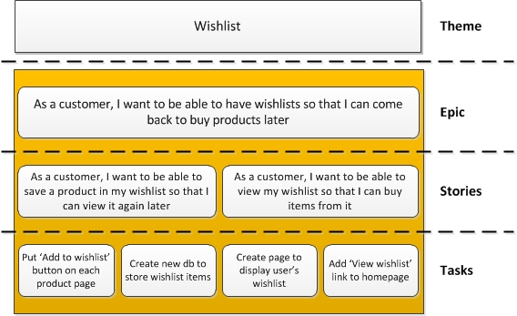
Theme, Epic, Story, Tasks
Theme: is a group of user stories that share a common attribute.
Epic: A “large user story” that can be broken down into a number of smaller stories.
Task: technical implementation of a story into a software feature
Reference: Agile101 blog, Tara Hamilton-Whitaker

Slide 32
Backlog
Product and Sprint Backlogs

Slide 33
Backlog
The agile product backlog in Scrum is a prioritized features list, containing short descriptions of all functionality desired in the product.
Typically, a Scrum team and its product owner begin by writing down everything they can think of for agile backlog prioritization.
This agile product backlog is almost always more than enough for a first sprint.
The Scrum product backlog is then allowed to grow and change as more is learned about the product and its customers.

Slide 34
Backlog
A typical Scrum backlog comprises the following different types of items:
Features
Bugs
Technical work
Knowledge acquisition

Slide 35
Backlog
Features and bugs are added to the product backlog.
They are the description of the wishes of the user/product owner

Slide 36
Backlog
Technical work and knowledge acquisition activities also belong on the agile backlog.
An example of technical work would be, "Upgrade all developers' workstations to Windows 10."
An example of knowledge acquisition could be a Scrum backlog item about researching various JavaScript libraries and making a selection.

Slide 37
Planning and Prioritization

Slide 38
Task Prioritization
The backlog is ordered according to priorities
There are several ways to prioritize the requirements in the backlog
MoSCoW
Business Value Based
Technology Risk Based
Kano Model
Walking Skeleton
Validated Learning

Slide 39
Task Prioritization: MoSCoW
M - MUST have this. (highest priority)
S - SHOULD have this if at all possible.
C - COULD have this if it does not effect anything else.
W - WON'T have this time but would like in the future.

Slide 40
Task Prioritization: Business Value Addition
In this case, each requirement carries a business value it could potentially generate to the company.
The business value would be decided either by the Product Owner or the Product owner team.
The requirement with highest business value is implemented during earlier releases .

Slide 41
Task Prioritization: Technology Risk Based
In this method, requirements are prioritized based on the risk associated in implementing it.
The risk is typically based on the technology.
The requirement with highest technology risk is implemented during the earlier iterations.

Slide 42
Task Prioritization: Kano Model
In this method, the requirements are prioritized based on the customer preferences.
Must-be (users take them for granted when done well, but are very dissatisfied when they’re missing)
One-Dimensional (satisfaction when fulfilled and dissatisfaction when not)
Attractive (these attributes provide satisfaction when achieved fully, but do not cause dissatisfaction when not fulfilled.)
Indifferent (These attributes refer to aspects that are neither good nor bad, and they do not result in either customer satisfaction or customer dissatisfaction)
Reverse (These attributes refer to a high degree of achievement resulting in dissatisfaction and to the fact that not all customers are alike)

Slide 43
Task Prioritization: Walking Skeleton
In this method, the requirements are selected such that minimal carefully selected end to end features are built within a short span of time.
“A walking skeleton, in a software development context, is a minimal initial implementation of an application's architecture that includes and connects the basic components of the system. As the name implies, the structure is in place and functional in a rudimentary way, but the system is not fleshed out and does not provide the level of service required of the end product. Subsystems are incomplete but hooked together.” [https://whatis.techtarget.com/definition/walking-skeleton]

Slide 44
Task Prioritization: Validated Learning
In this method, features are chosen based on the highest market risk i.e. some thing that is not experimented yet.
Release it to the market, get the customer feedback and apply this feedback (or learning) onto the new feature.

Slide 45
Estimation
Programmers often consider estimating to be a black art—one of the most difficult things they must do. Many programmers find that they consistently estimate too low.
To counter this problem, they pad their estimates (multiplying by three is a common approach), but sometimes even these rough guesses are too low.
Are good estimates possible?

Slide 46
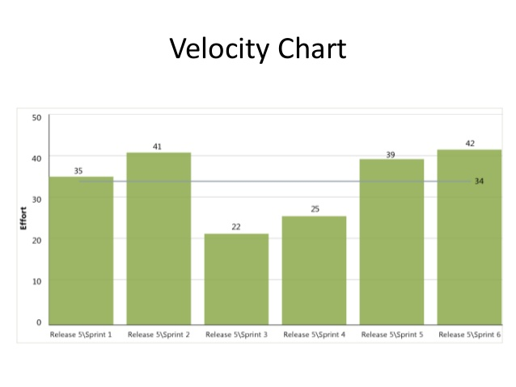
Velocity
Your velocity is the number of story points you can complete in an iteration.
It’s a simple yet surprisingly sophisticated tool. It uses a feedback loop, which means every iteration’s velocity reflects what the team actually achieved in the previous iteration.

Slide 47
Velocity effect
When the team underestimates their workload, they are unable to finish all their stories by the iteration deadline.
This causes their velocity to go down, which in turn reduces the team’s workload, allowing them to finish everything on time the following week.

Slide 48
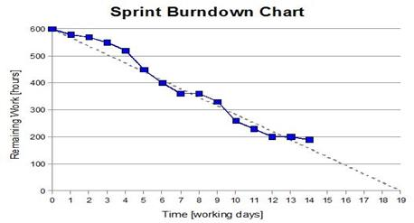
Burndown
In other words, what’s been done vs. what’s been estimated.
How does it relate to velocity?

Slide 49
What to do when velocity drops
Pay down technical debt – code quality improvement
Improve customer involvement – they should answer questions
Support energized work – e.g., no overtime policy
Offload programmer duties – limit distractions
Provide needed resources – invest in hardware and other resources
Add programmers (carefully) – add people but only when necessary

